Slide 1
Brainstorming and Prototyping
Batch 12, Group D
18/10/2020

Slide 2
Today’s Presentation
Introduction
Our Brainstorming Session
Our Idea
Our Prototype
Things We Learned

Slide 3
1. Introduction
Brainstorming and Prototyping

Slide 4
Introduction
This is part of a Design Thinking (DT) project. The DT challenge is to raise the approval rating of the AP state government to 90%.
In this session, we are going to cover
Importance of Safety on roads.
The designing of safety elements for automobiles for safety of people in AP.

Slide 5
2. Our Brainstorming Session
Brainstorming and Prototyping

Slide 6
Our Process
Details of our brainstorming process
• We held our brainstorming session on 17th October 2020
•7 members of our group are involved in brain storming
•We used Random Prompts, Counterfactuals, Perspective shifting, Worst idea, Journey to the future
•We got around 20 ideas in our brainstorming session
•We evaluated based on need of people and for 90%approval rating of AP state

Slide 7
Random Prompts
Think of a solution that begins with the letter D?
Drones to keep track on traffic.
Driverless vehicles.
Drivers with professional training.
What solution do you think of when you read the word “Accidents”?
Sensors in vehicles that alert in case of accidents
Vehicle starts by detecting alcohol percent in the driver

Slide 8
Counterfactuals (Imaginary World)
Flying Vehicles
Holography concept at zebra crossing
Worst Ideas
Decreasing traffic Signals
Increasing traffic signals
Uneven roads
Even roads

Slide 9

Journey to the Future
Robots for traffic control
Driverless cars
Flying cars
Perspective Shifting
Highlighting accident prone areas in Google Maps.
Google assistant (or Siri) that warns when speed limit increases while driving

Slide 10
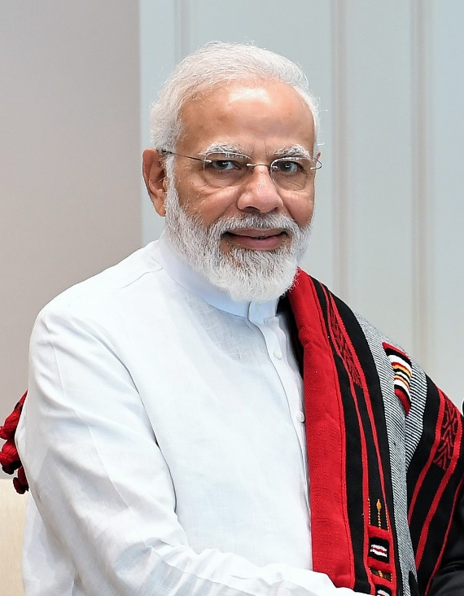
Perspective Shifting
Increasing lanes on the highways
Increasing fly Overs
Strict laws on traffic rules violation

Slide 11

3. Our Idea
Brainstorming and Prototyping

Slide 12
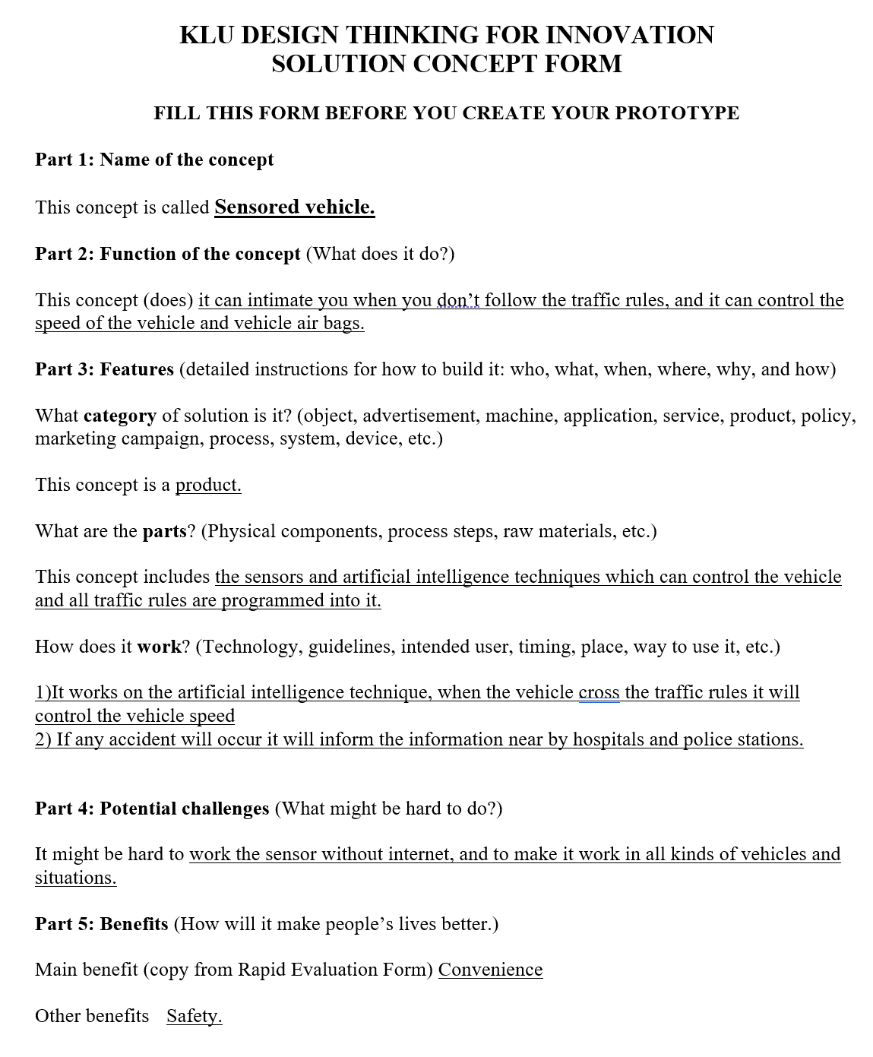
Our Selected Idea
Our selected idea is about Sensored Vehicle
It comes under the category of product solution.
It works under artificial intelligence Technique.
The sensor warns the people who are not following the traffic rules and also controls the speed of the vehicles.
It also provides the accidental information to the nearest hospitals and police stations for immediate help to the victims.

Slide 13
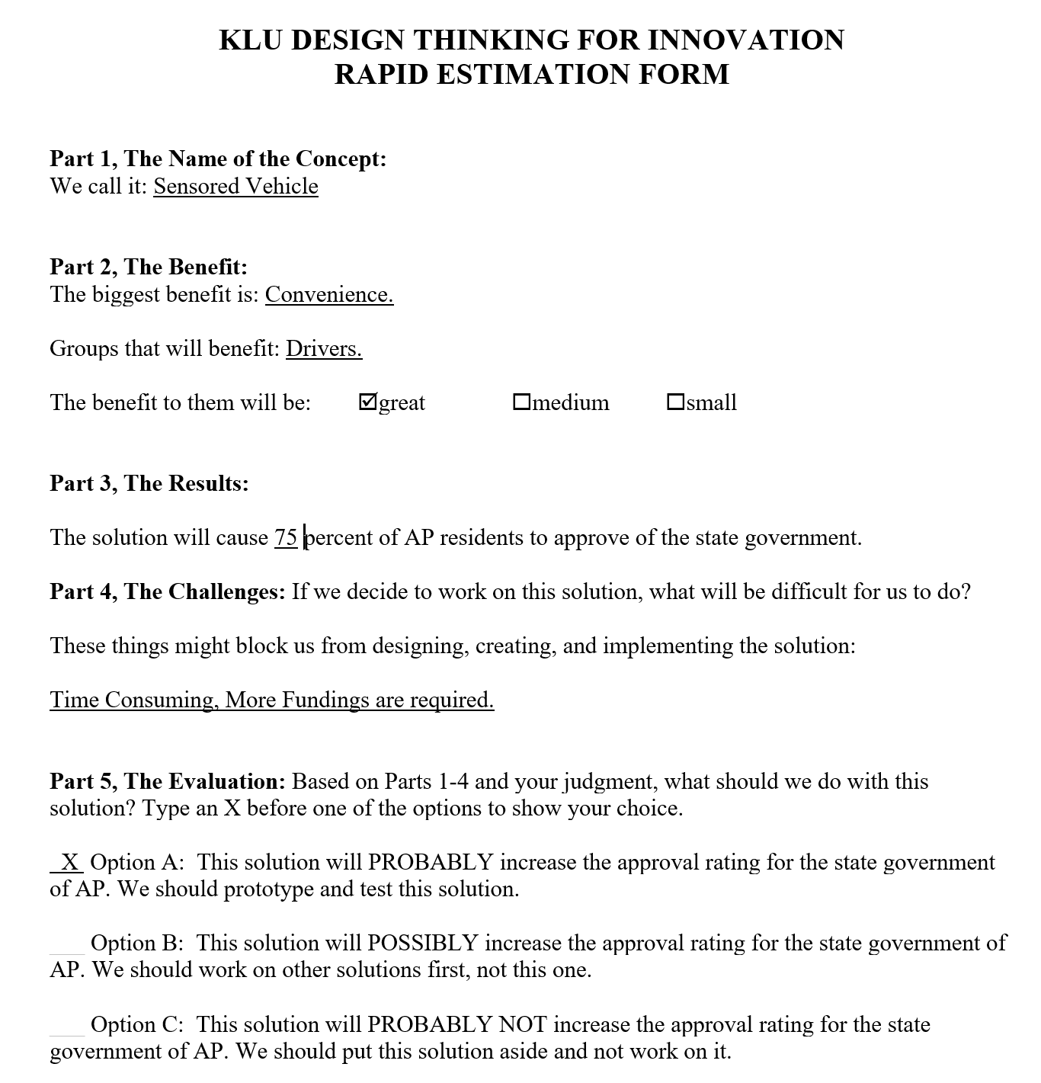
Our Justification
Now a days all automobiles are driven by sensors based​ technology. Hence, we think developing a sensor for the safety of people is the best idea.
Basis for Evidence:
Air bags.
Power steering.
Fuel indicators.
Safety belts.
Largest market size​:
75 % of total vehicles sold.
Least time to develop​
Approximately 100 days.

Slide 14
4. Our Prototype
Brainstorming and Prototyping

Slide 15
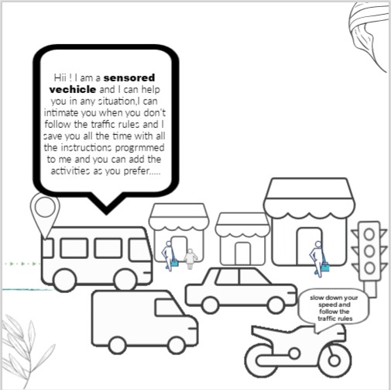
Our Concept Prototype
All the group members are participated in the creation of the prototype.
Benefit(s) that the prototype is supposed to communicate:
Warning the people in right times.
Prevention of accidents
Communication to hospitals
Communication to police stations.

Slide 16
5. Things We Learned
Brainstorming and Prototyping

Slide 17
Lessons Learned
We discussed the importance of safety and safety devices .
Knew about the present technologies using in automobiles.
Got knowledge in using the technologies for new innovations.
Due to Brain storming and Prototype, we got the confidence that we can develop the new products required for the people regarding safety on roads.

Slide 18
Thank You…! 👍
From Batch – 12 Project – D

